Slide 1
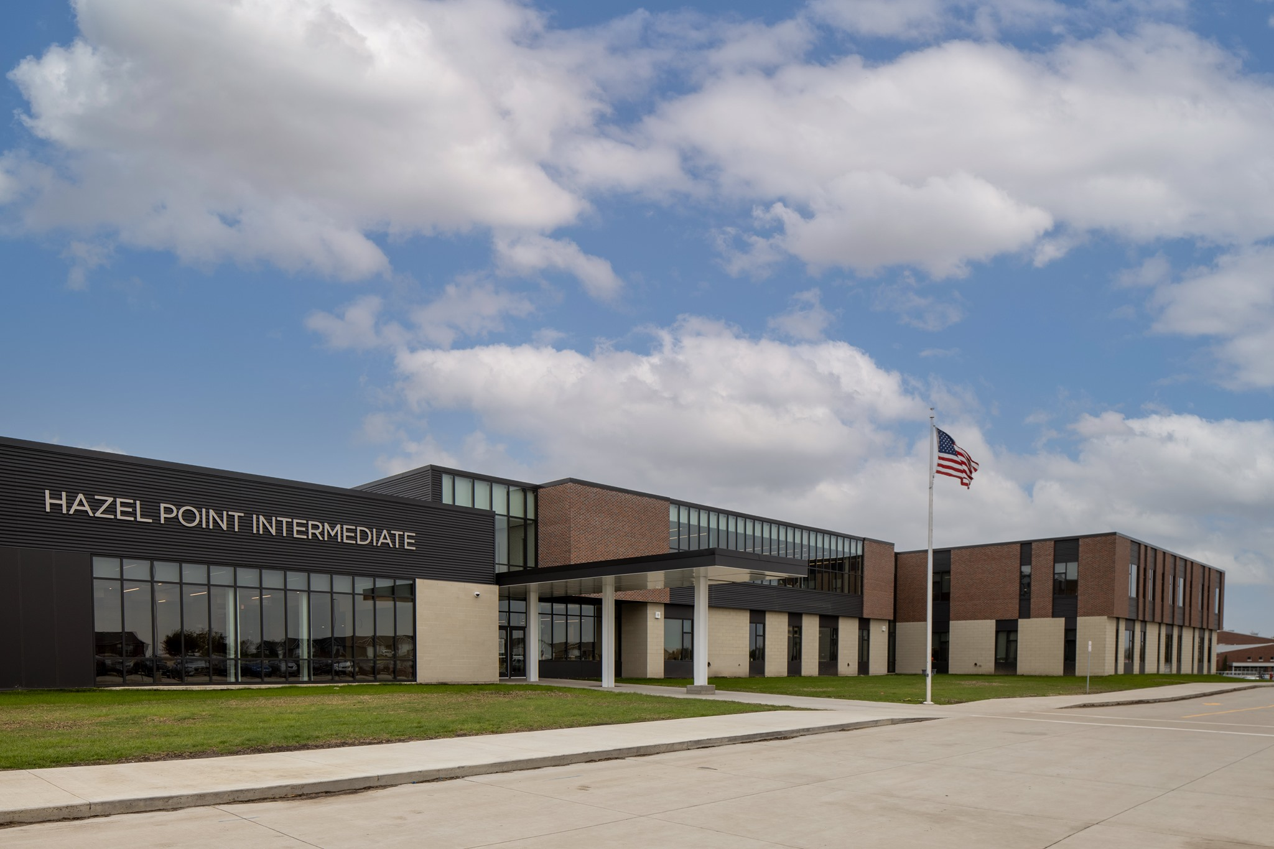
Welcome to Hazel Point!

Slide 2
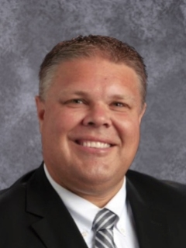
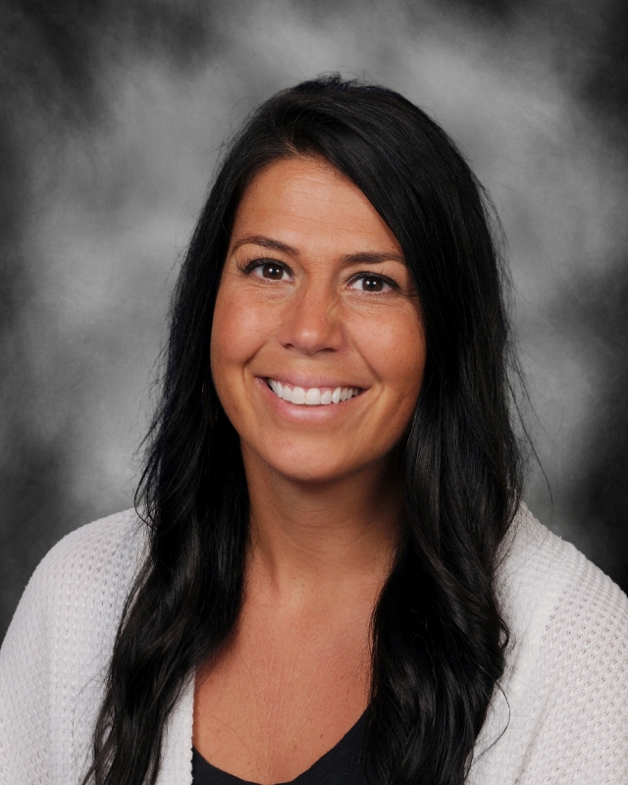
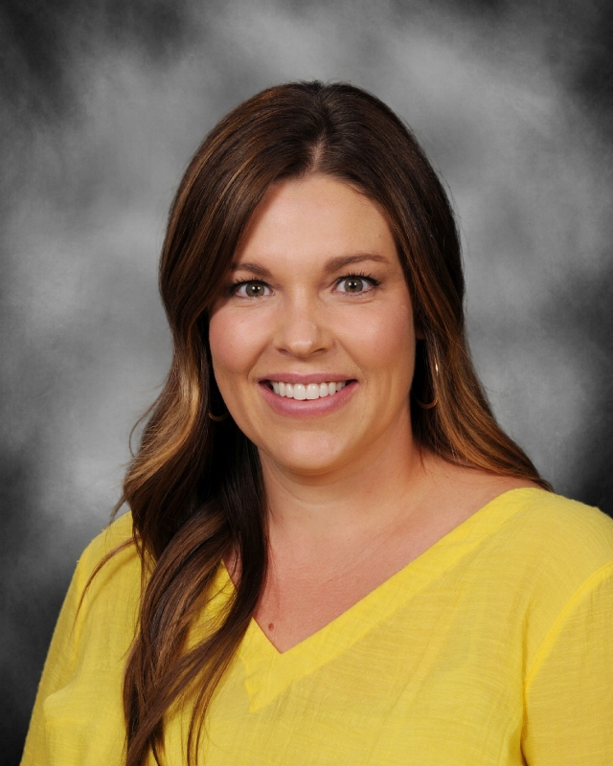
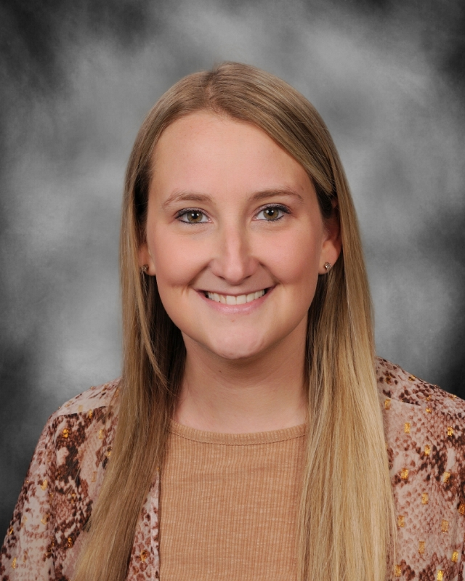
Introductions
Mr. Buchholz
Principal
Mrs. Fechner
Associate Principal
Mrs. Adair
School Counselor
Mrs. Cooling
School Counselor

Slide 3
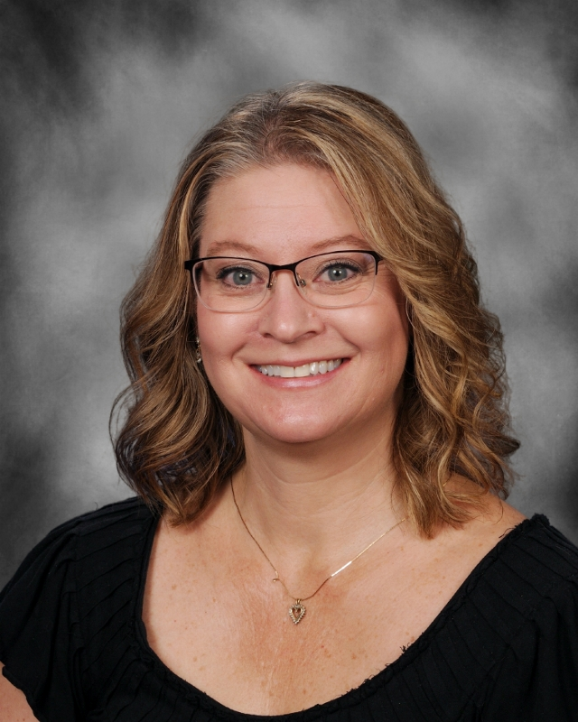
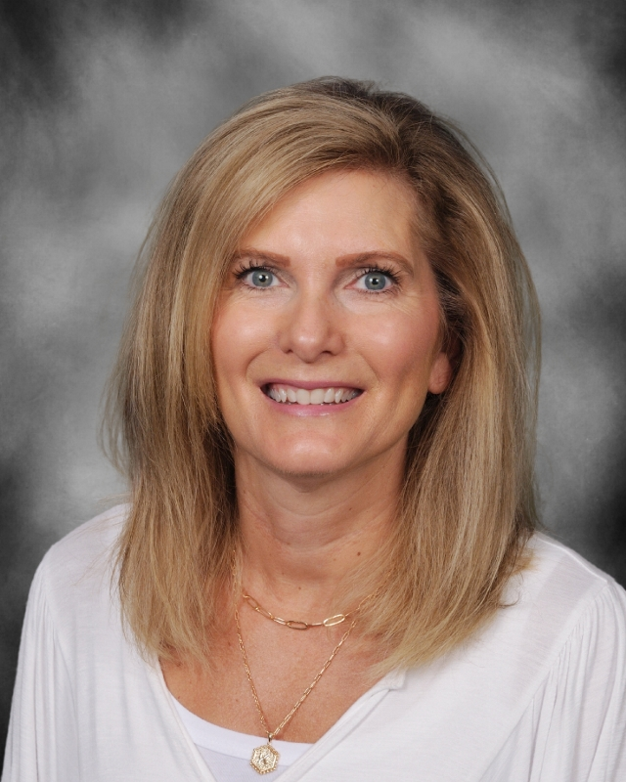
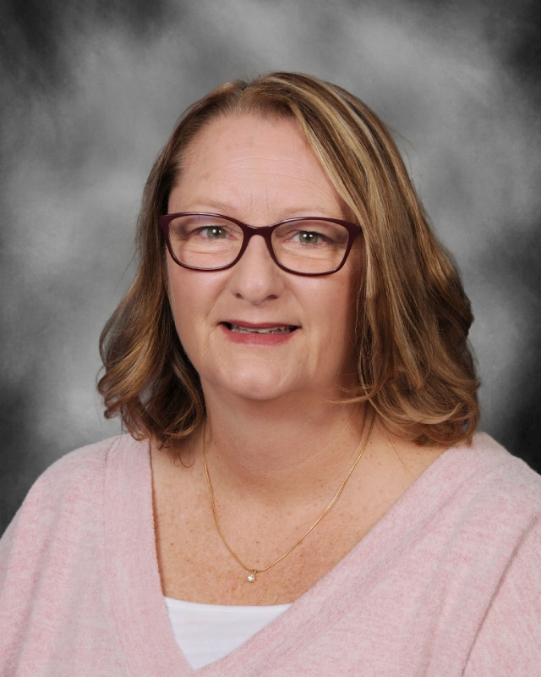
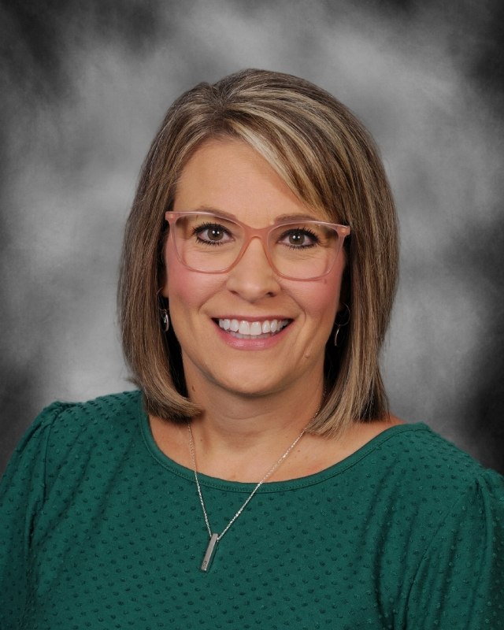
Introductions
Mrs. Kane
Secretary
Mrs. Leuenberger
Secretary
Mrs. Dunnwald
Nurse
Mrs. Fredrickson
Nurse Assistant

Slide 4
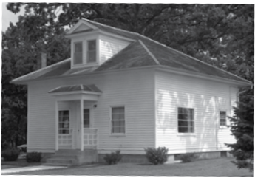
School History
Newly opened in the Fall of 2020 along with Boulder Peak Intermediate
Linn-Mar moved 5th out of Elementary; 6th out of Middle School
Named after a former one-room schoolhouse at Linn-Mar known as Hazel Ridge. Name was adjusted to avoid confusion with Oak Ridge.
5th and 6th grade are organized into smaller schools within the larger school known as HOUSES.
Each of our HOUSES is named after a former one-room schoolhouse at LM.
Concord, Lakeside, Wildcat, Northstar, Pleasant Grove, Hillsdale, etc.

Slide 5
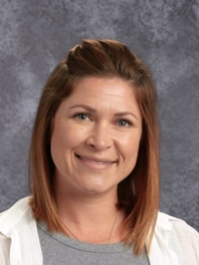
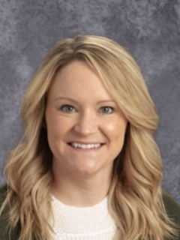
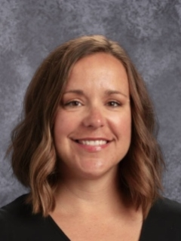
Meet the 5th Grade Teachers:
Wildcat House
Mrs. Hachey
Mrs. Hammes
Mrs. Henderson
TBD

Slide 6
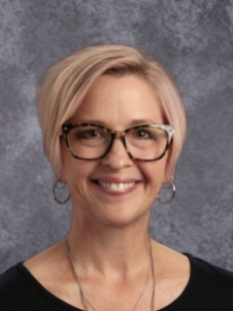
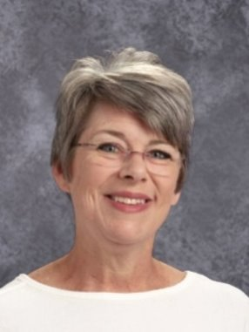
Meet the 5th Grade Teachers:
Concord House
Ms. Sydnes
Ms. Fitzpatrick
TBD
TBD

Slide 7
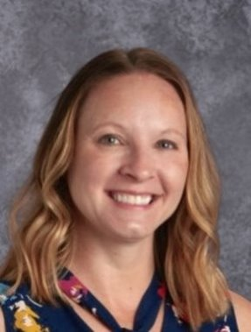
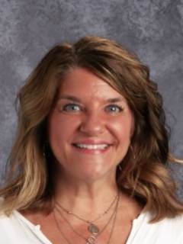
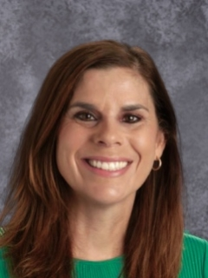
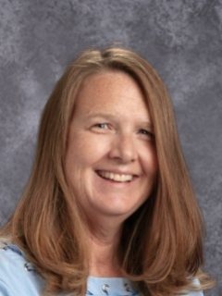
Meet the 5th Grade Teachers:
Pleasant Grove House
Mrs. Chipman
Mrs. Rodeffer
Mrs. Cummings
Mrs. England

Slide 8
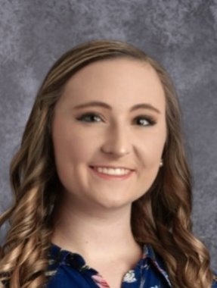
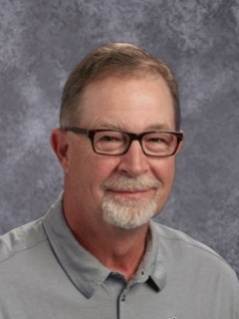
Meet the Specials Teachers
General Music
Miss DeCamp
Art
Mr. Hammann
P.E.
Mr. Evans
P.E.
Mr. Whitson

Slide 9
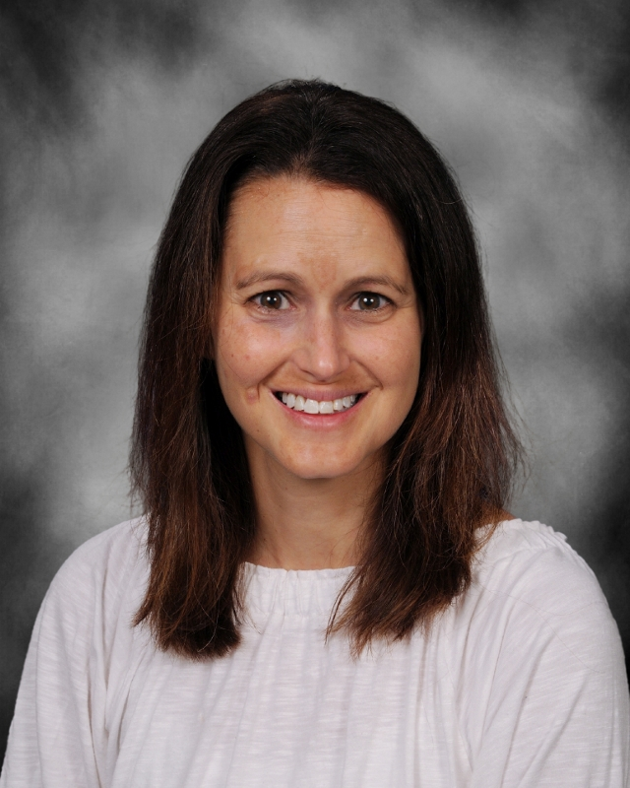
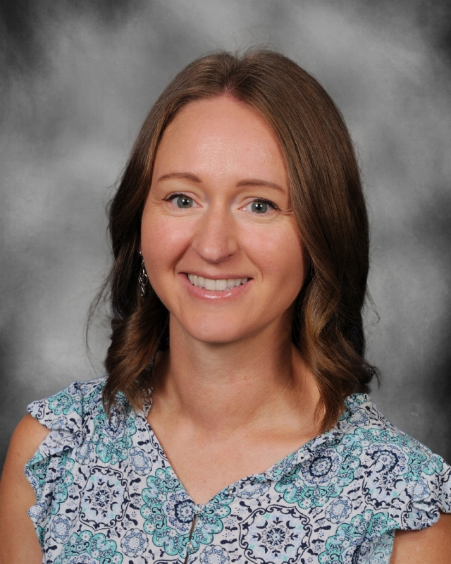
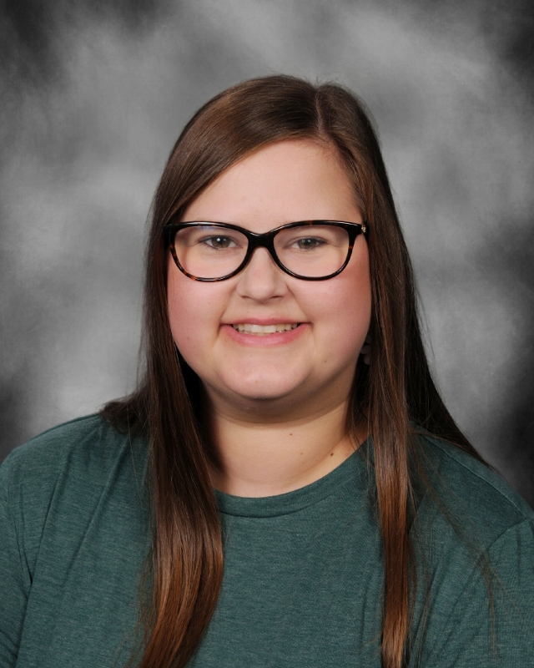
Meet the Fine Arts Teachers
Band
Mrs. Nuss
Orchestra
Mrs. Schamberger
Vocal Music
Ms. Fontenot
Band
Mr. Kelly

Slide 10
Who are Early Adolescents?
●Seeking independence in their routine
●Ego-centric mindset. It is all about ME!
●Will seek change in friendships and peer connections based on their revolving interests and changing personality.
●Decision-making can be socially-focused. Sometimes impulsive.
●Rapid development of the brain is occurring and can create a variety of different feelings and emotions. Hormonal changes may also have a direct effect on feelings and emotions in 5th and 6th graders.
●Structure and routine is important in their home and school settings.
●Be careful when offering social media platforms and individual tech time.

Slide 11
School Day Schedule (general)
7:30am - students may begin arriving & entering the building for breakfast
7:40am - FIRST BELL - students may report to classrooms
7:50am - SECOND BELL - students should be in their seats & ready for the pledge
● Each HOUSE determines their instructional schedule around pre-determined Specials, Lunch/Recess, and Fine Arts FLY.
2:35pm - DISMISSAL BELL

Slide 12
Student Schedule
Students are randomly assigned to a “House” which is a school within a school
Students will have two teachers each day that teach their core subjects
One teacher - Math & Science
Second teacher - Literacy (Reading and Language/Writing) & Social Studies
Specials (Phys. Ed, Music, Art) are built into the school day
Students DO NOT change into PE clothing
FLY time
Fine Arts (Band, Orchestra, Vocal)
Learning focused opportunities for students (skill-based and individualized)
Lunch & Recess - 40 minutes for all students
Playground is located behind Hazel Point

Slide 13
Fine Arts - Band, Orchestra, Vocal
All students have the opportunity to participate in Band, Orchestra and/or Vocal
Rehearsals are held during the school day during FLY time
Beginner Parent Informational Meetings:
Band – Wed. May 10 at 6:00 PM in Hazel Point Cafeteria
Orchestra – Wed. May 10 at 7:00 PM in Hazel Point Cafeteria
If you have further questions, reach out to one of our instructors below:
Band: Kevin Makinster - kmakinster@linnmar.k12.ia.us Stephanie Nuss - snuss@linnmar.k12.ia.us
Orchestra: Kristi Schamberger - kschamberger@linnmar.k12.ia.us
Vocal: Liz Fontenot: liz.fontenot@linnmar.k12.ia.us

Slide 14
Lockers
Each student will be assigned a locker in their House
Lockers DO NOT have combination locks
Students may bring their backpacks to and from school to carry their devices and other materials.
Backpacks will be left in their lockers during the day.
Students will only use their lockers to store materials - unnecessary to bring additions, decorations, etc. for their lockers

Slide 15
Technology
All students are assigned a laptop to be used throughout the day at school. We will build responsibility around the use and care of the device for all students.
Schoology - platform that teachers & students utilize in the classroom and virtually, if necessary.
Cell Phones are strongly discouraged. Students are expected to silence them and have them away while inside the building, and throughout the school day (7:30-2:35). They are unnecessary for any school use as laptops can support all technology tools in the classroom.

Slide 16
Student Activities
Student Interest Clubs and Activities (Yearbook, LegoLeague, Speed-Cubers, Lion Leaders)
Alternate Recess Options: Art- (Artist Studio), Library (Battle of the Books), Gym (Indoor activities), Music (Ukulele Club, Composer Study), Band/Orchestra (additional practice)
Activity Night

Slide 17
PBIS
PBIS at Hazel Point focuses on the 3 R’s: Respect, Responsibility, and Right Attitude
Posters with common language are hung up around the school to remind students and staff of what the 3 R’s look like in common areas such as classrooms and cafeteria and on the playground
Students and staff worked together to create an acknowledgement system centered around building our school community positively.
We have a building-wide assembly before Thanksgiving Break and do other monthly celebrations go acknowledge our students.
Pick-A-Ticket Tuesday, VIP Lunch Friday

Slide 18
Counseling
Counselors work with teachers, staff, parents and community resources to address the academic, career and social/emotional needs of all students.
Roles include:
providing short-term counseling
making referrals for long-term support
offering small groups to identified students
collaborating with teachers, parents and administration

Slide 19
PowerSchool eRegistration
Online registration is completed for all students in PowerSchool
Online Registration allows you to:
Register for the upcoming school year
Make address, phone number & email changes
Set permissions for your student
Pay school fees and/or put money into your student’s lunch account
Opens in early August before the start of school
Up-to-date information is extremely important! Changes can be made throughout the school year, if necessary.

Slide 20
Drop Off / Pick Up Procedures
Drop off (beginning at 7:30am)
Car Riders: enter the drive lane/parking lot from Echo Hill Road; form a single file line of cars in front of the building
Walkers, Bike Riders & Car Riders will enter the building inside Door 1 (main set of doorways)
Bike racks are located on the northwest corner of the school (between Hazel Point and Echo Hill Elementary)
Bus riders: buses drop off at the rear of the building
Dismissal (at 2:35pm)
Car riders: enter the drive lane/parking lot from Echo Hill Road; form a single file line of cars in front of the building; once your student enters your vehicle, you may pull out to the left lane & proceed to the exit of the parking lot
Walkers/Bike Riders: use the safe crosswalks at Echo Hill Road or the walking paths around the east side of Echo Hill Elementary

